Slide 1
Exercise 13
Phyla Platyhelminthes and Nematoda

Slide 2
In this lab exercise, you observed the wide diversity of animals in the phyla Platyhelminthes and Nematoda. You will be expected to recognize each group and their distinguishing characteristics. Consult your lab manual for the role of each in its environment, the structures that you will need to recognize on each specimen, and their functions. Pay attention to which are parasites and which are free-living. As in all exercises, concentrate on those structures in bold face type and those that you were asked to label on your diagrams.

Slide 3
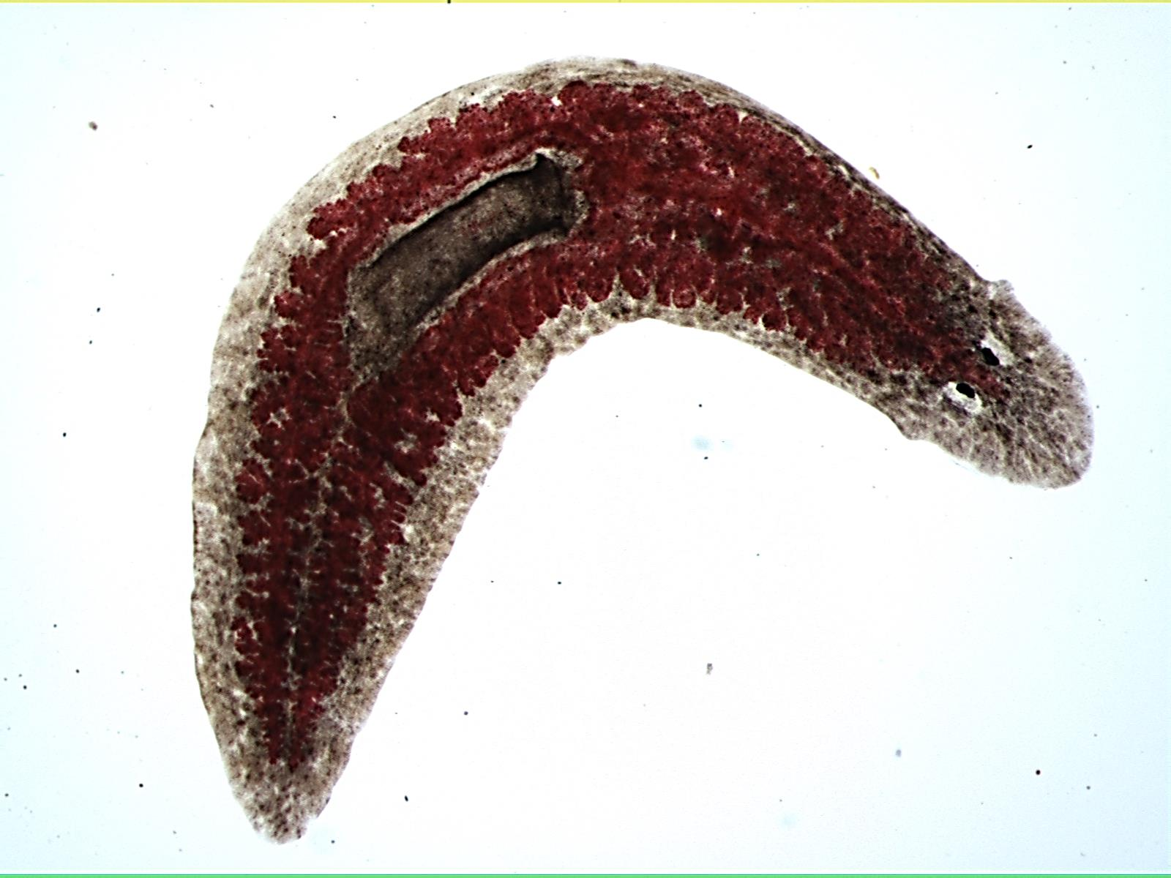
Planaria whole mount

Slide 4
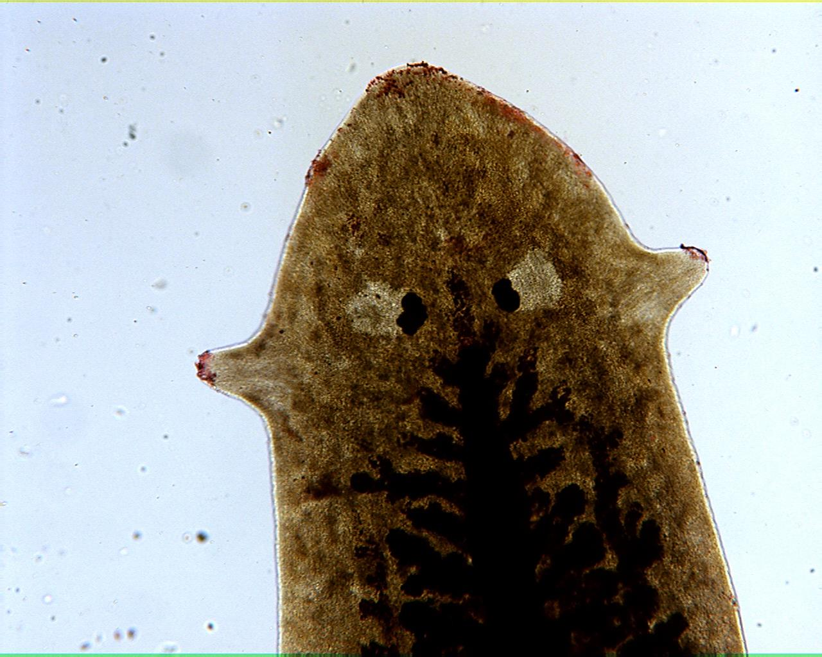
Planaria whole mount

Slide 5
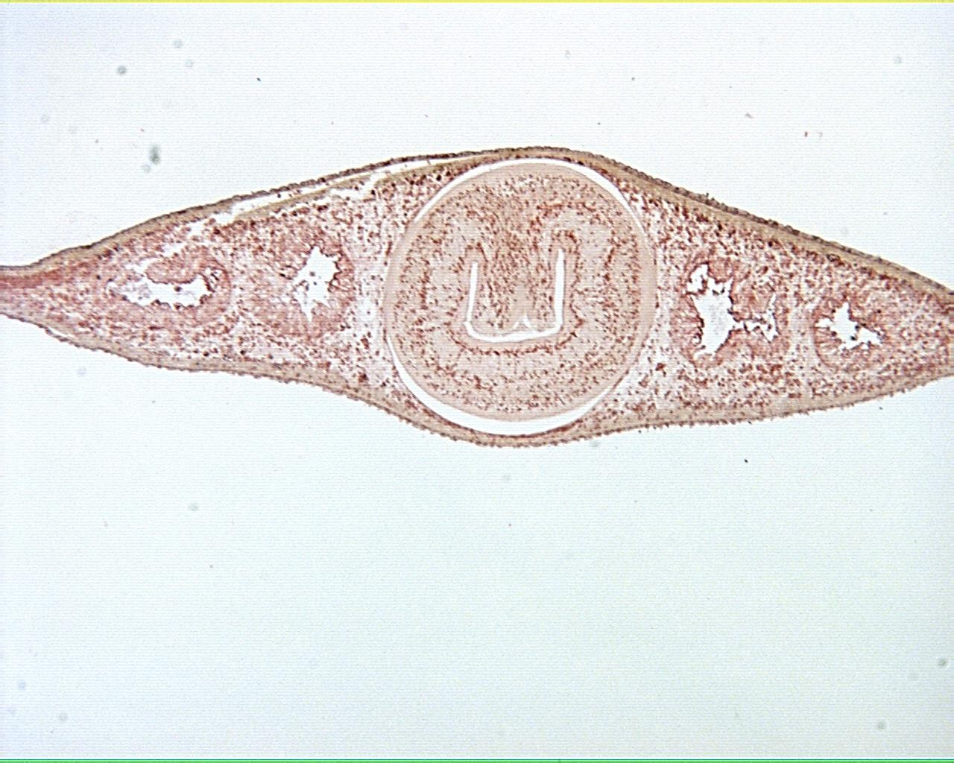
Planaria xs 40X

Slide 6
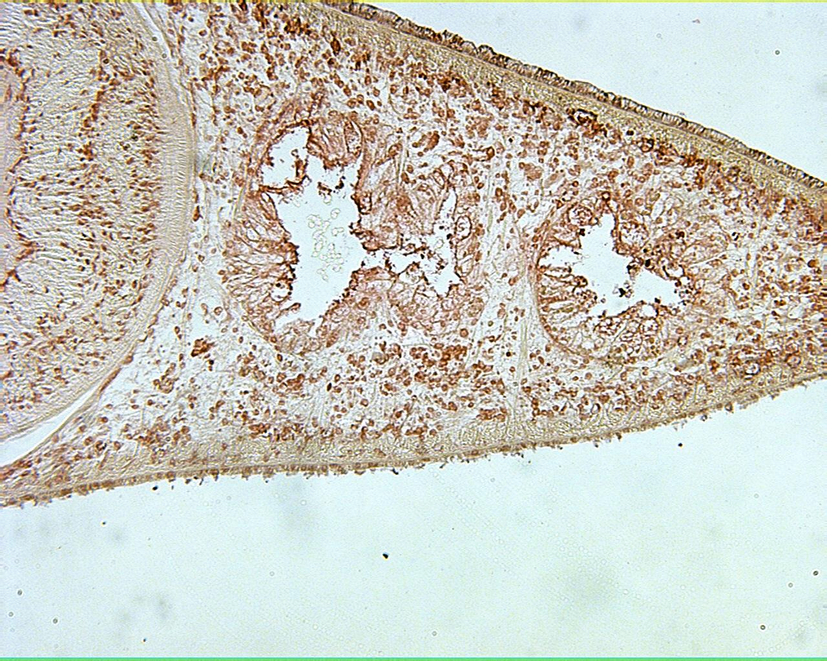
Planaria xs 100X

Slide 7
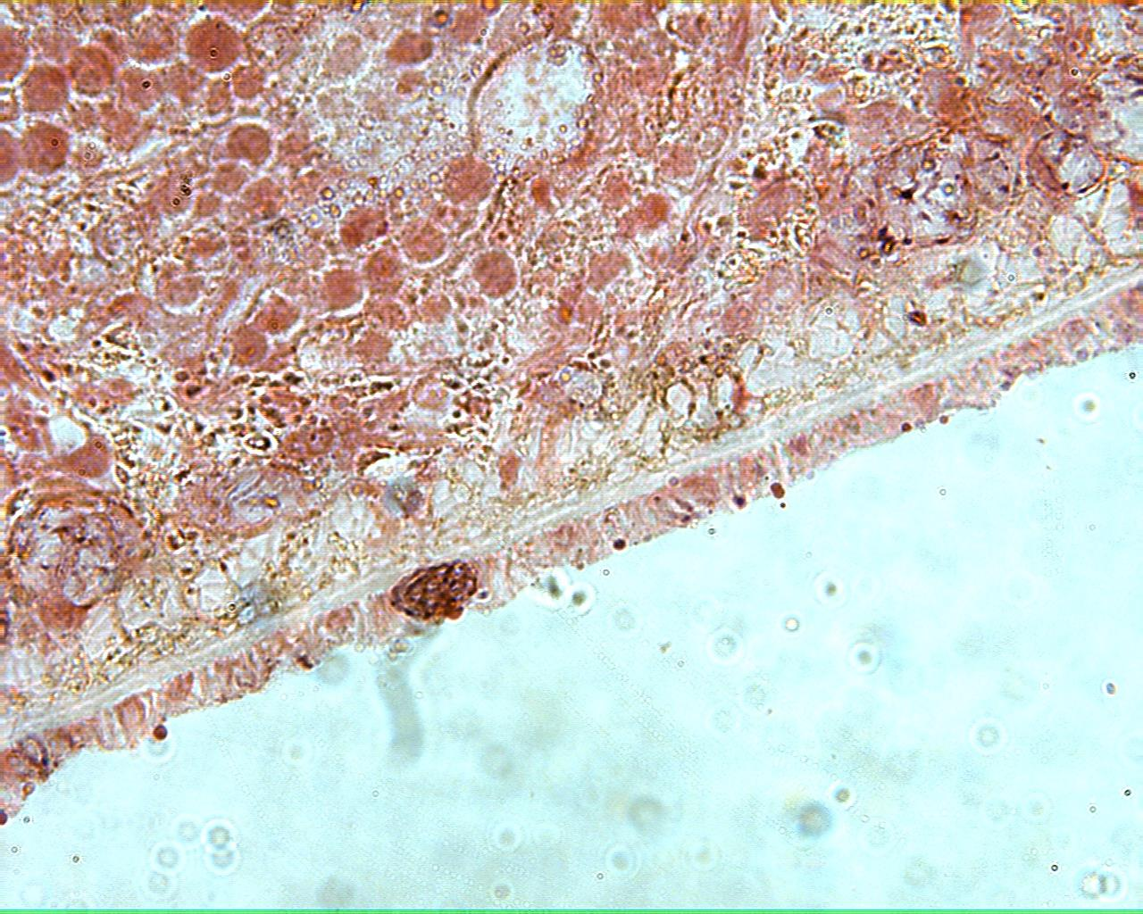
Planaria xs 400X

Slide 8
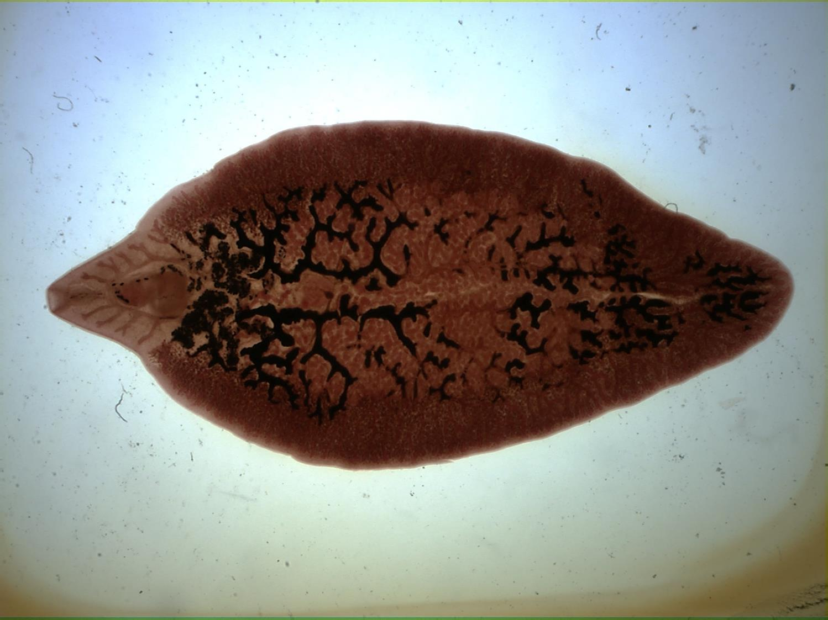
Fasciola whole mount

Slide 9
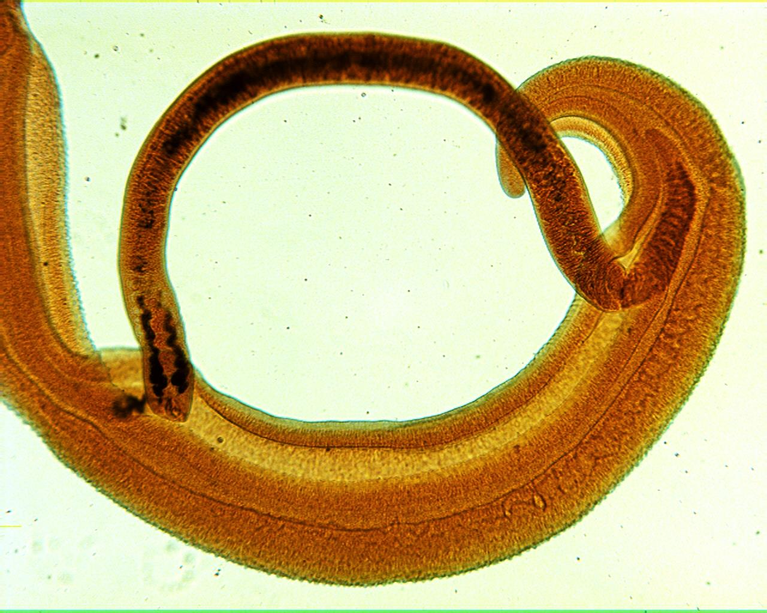
Schistosoma male and female 40X

Slide 10
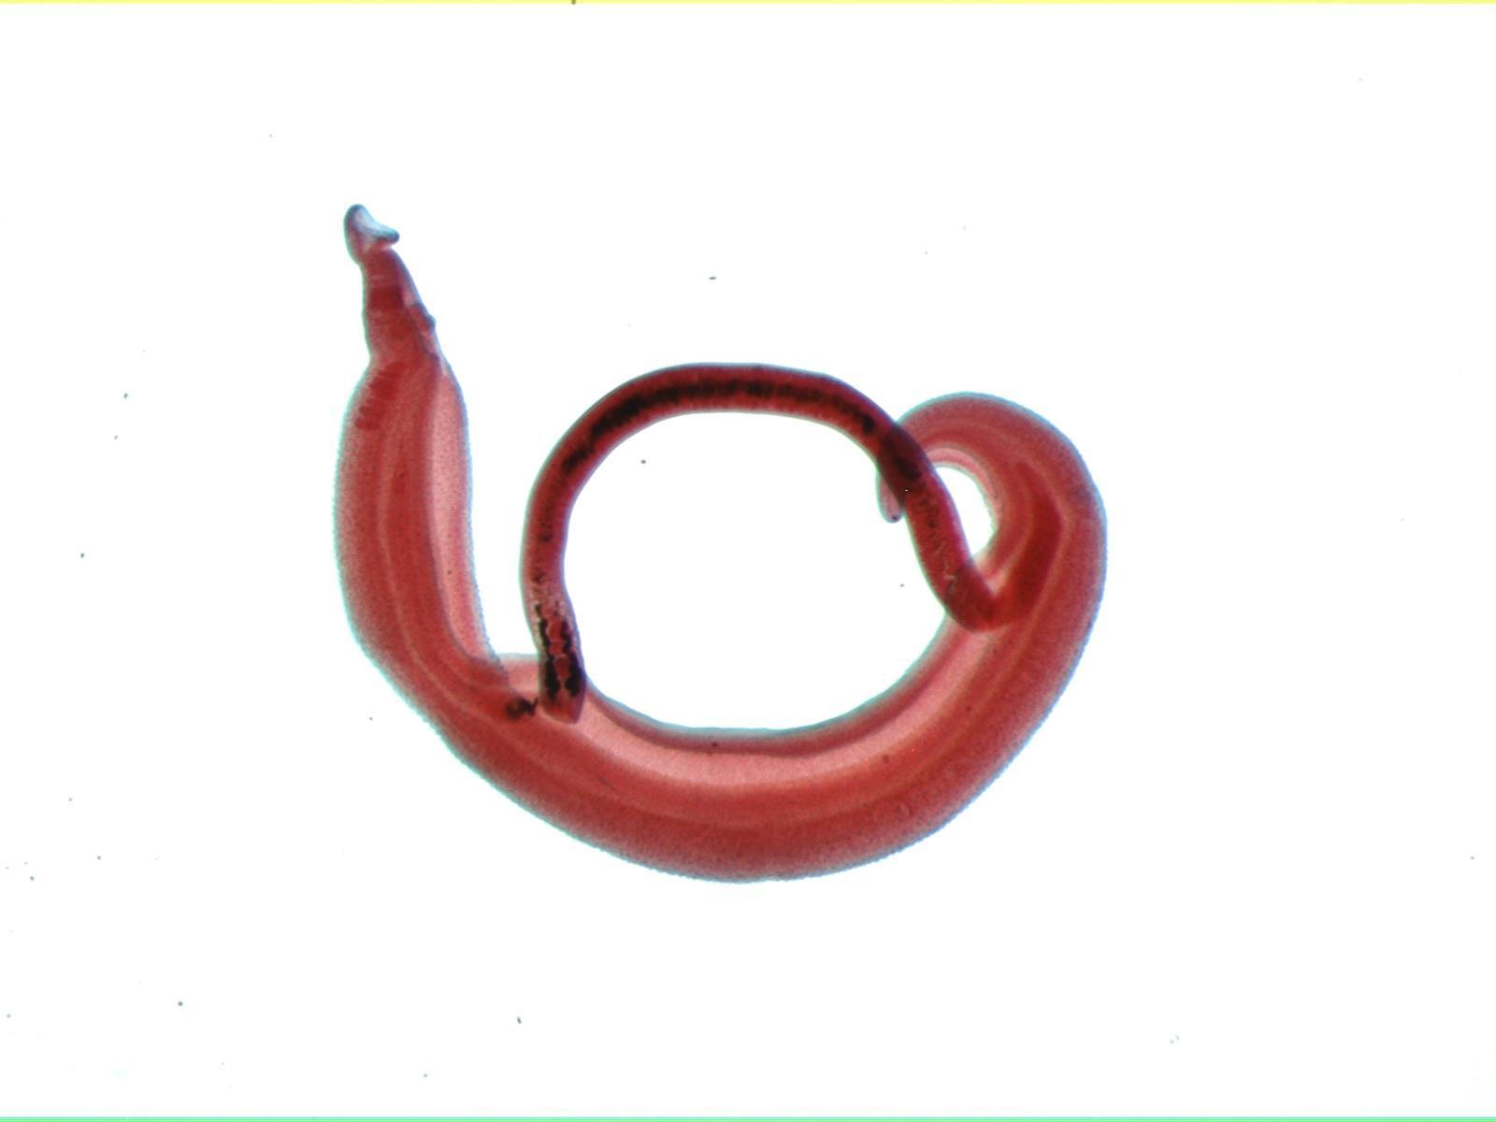
Schistosoma male and female

Slide 11
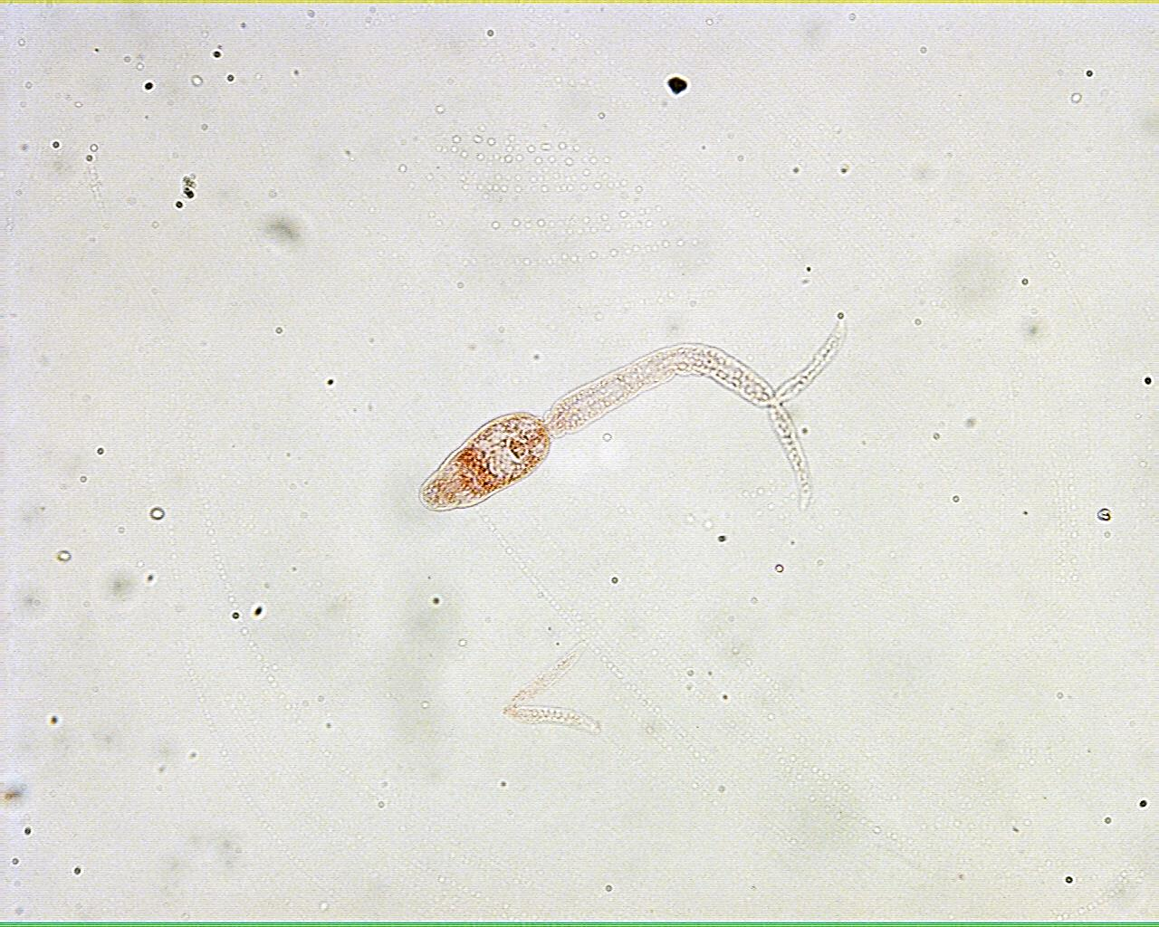
Schistosoma cercaria

Slide 12
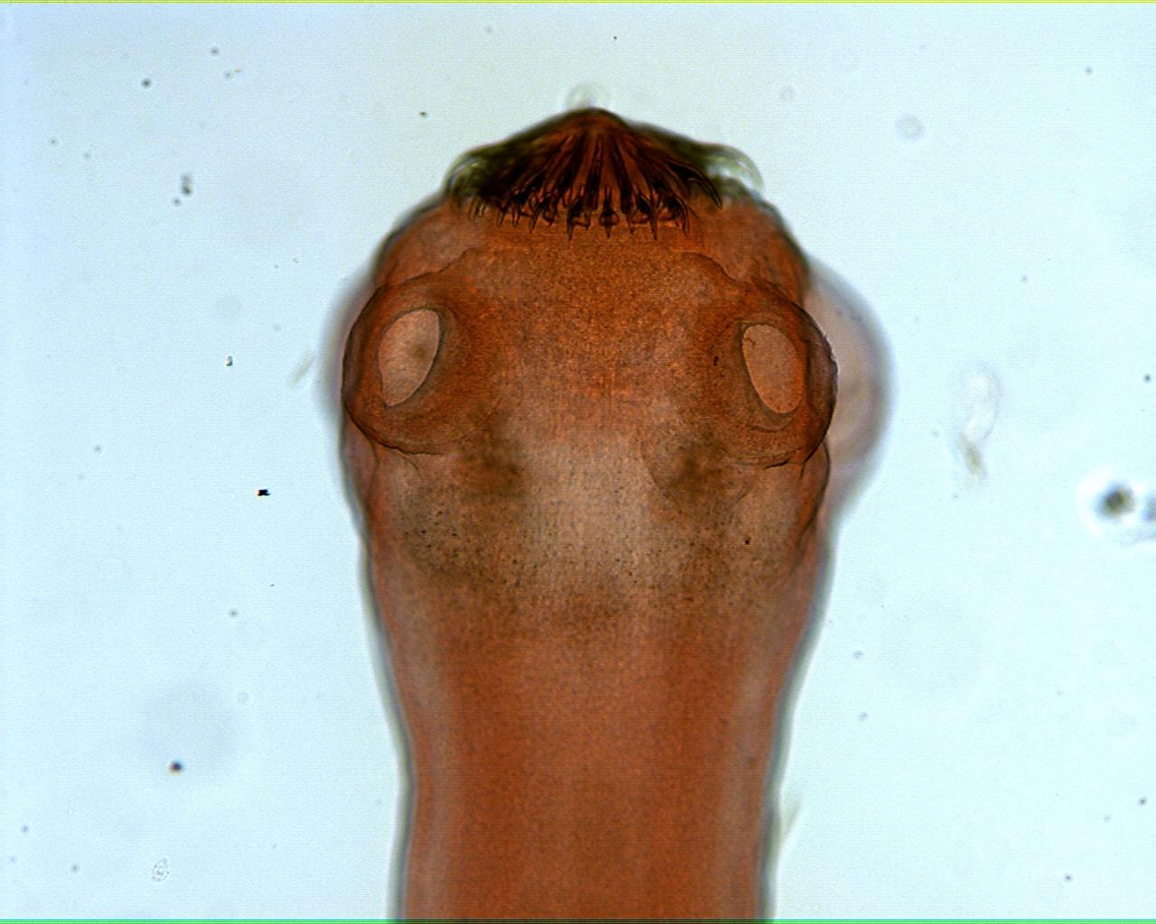
Tapeworm scolex

Slide 13
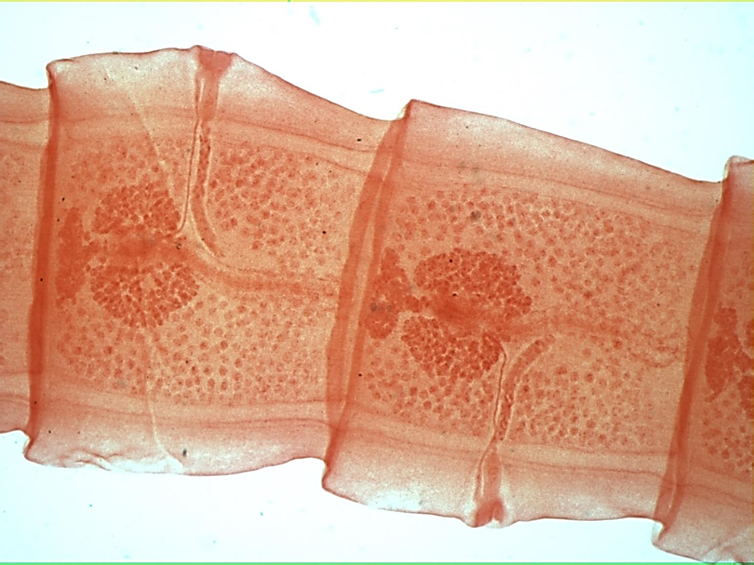
Tapeworm mature proglottid

Slide 14
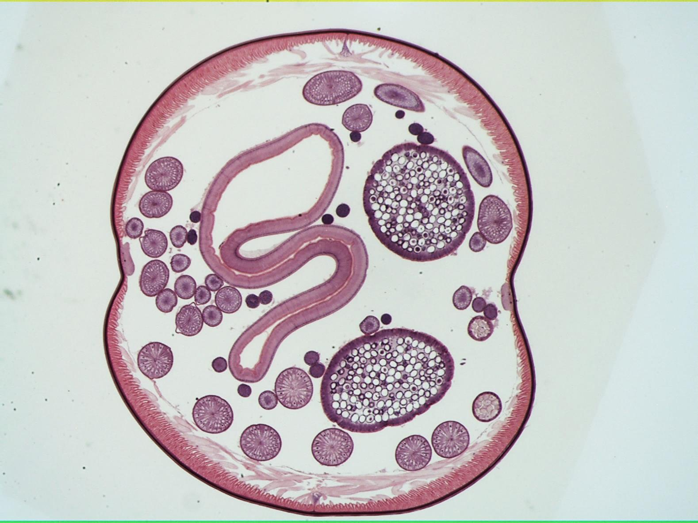
Ascaris xs

Slide 15
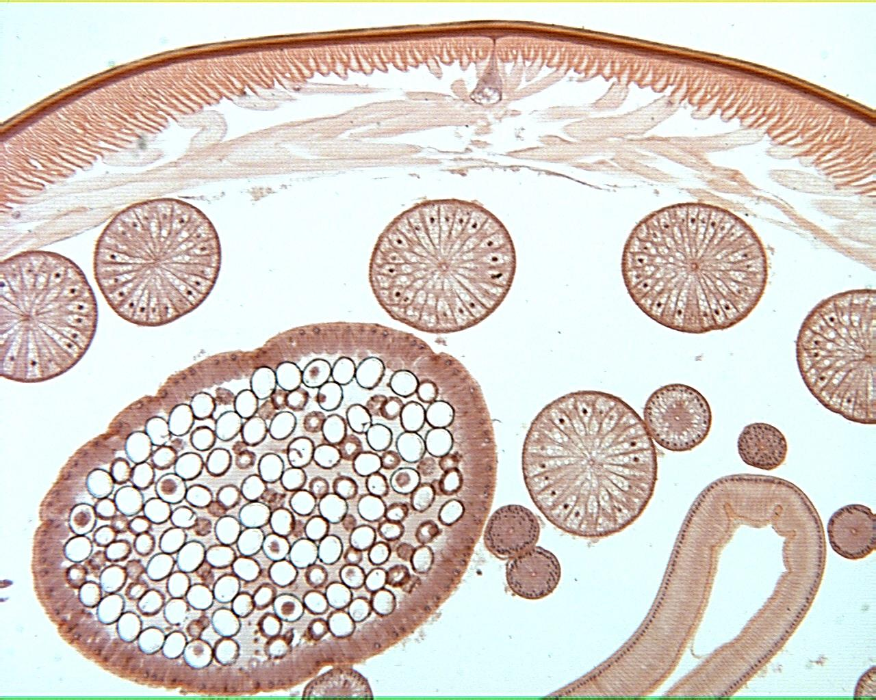
Ascaris xs 40X

Slide 16
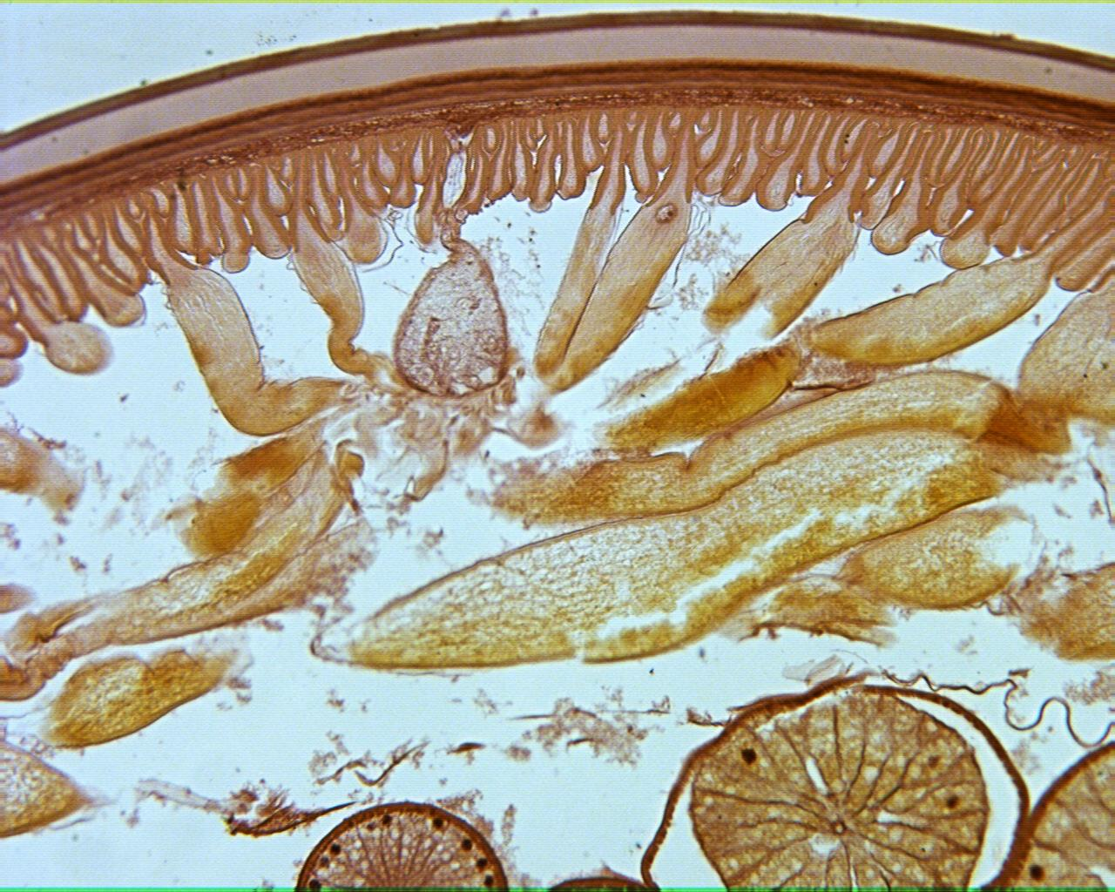
Ascaris xs 100X

Slide 17
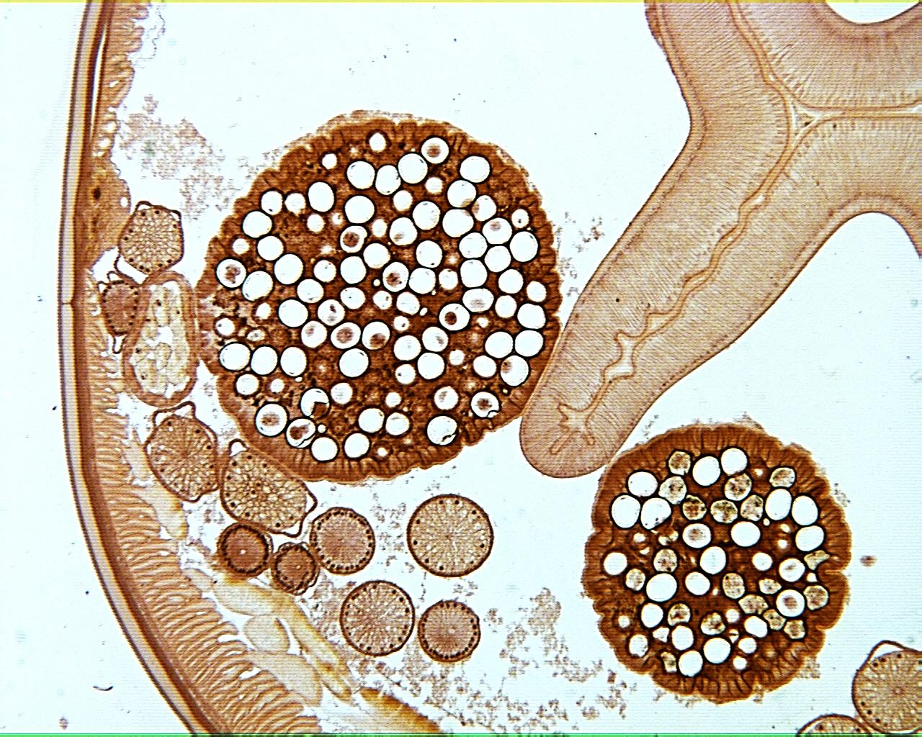
Ascaris xs 40X

Slide 18
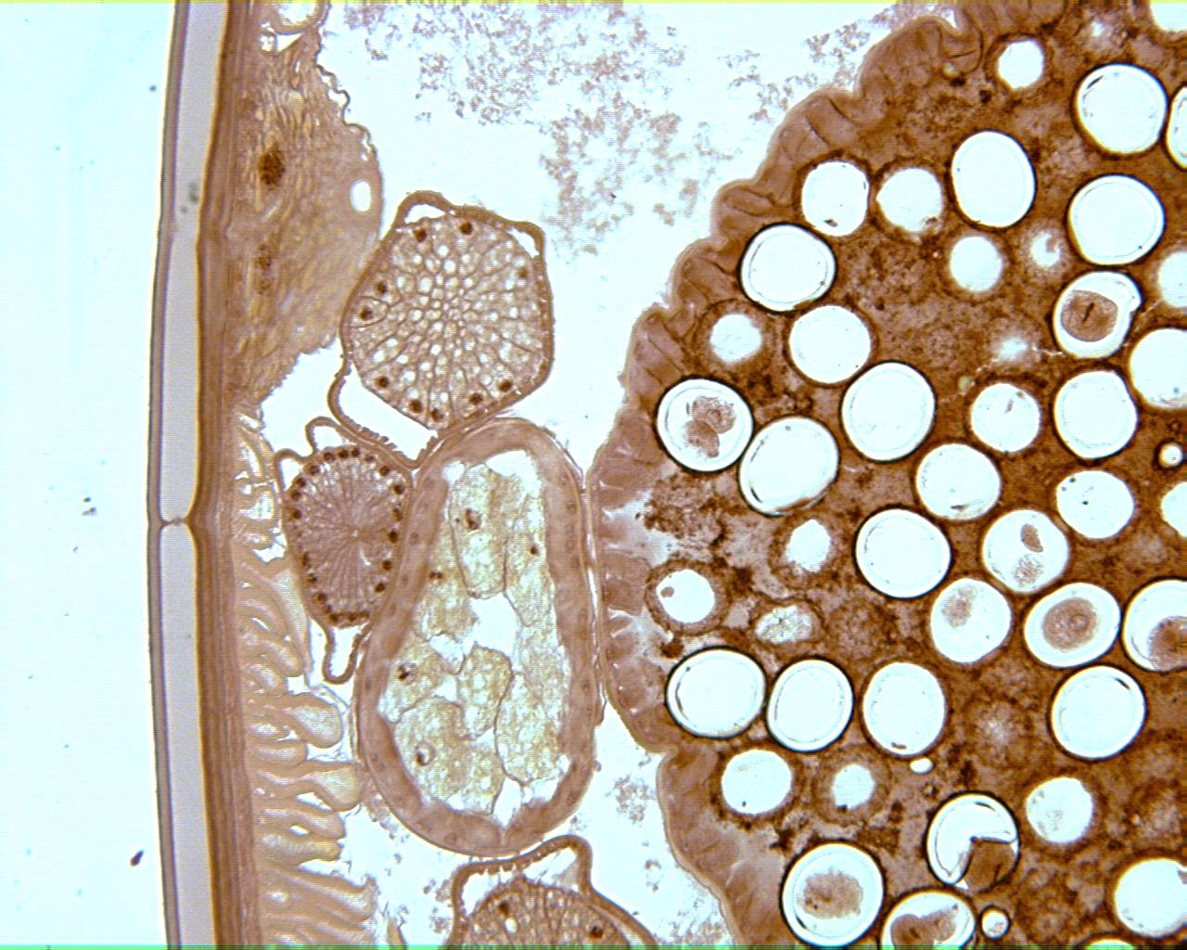
Ascaris xs 100X

Slide 19
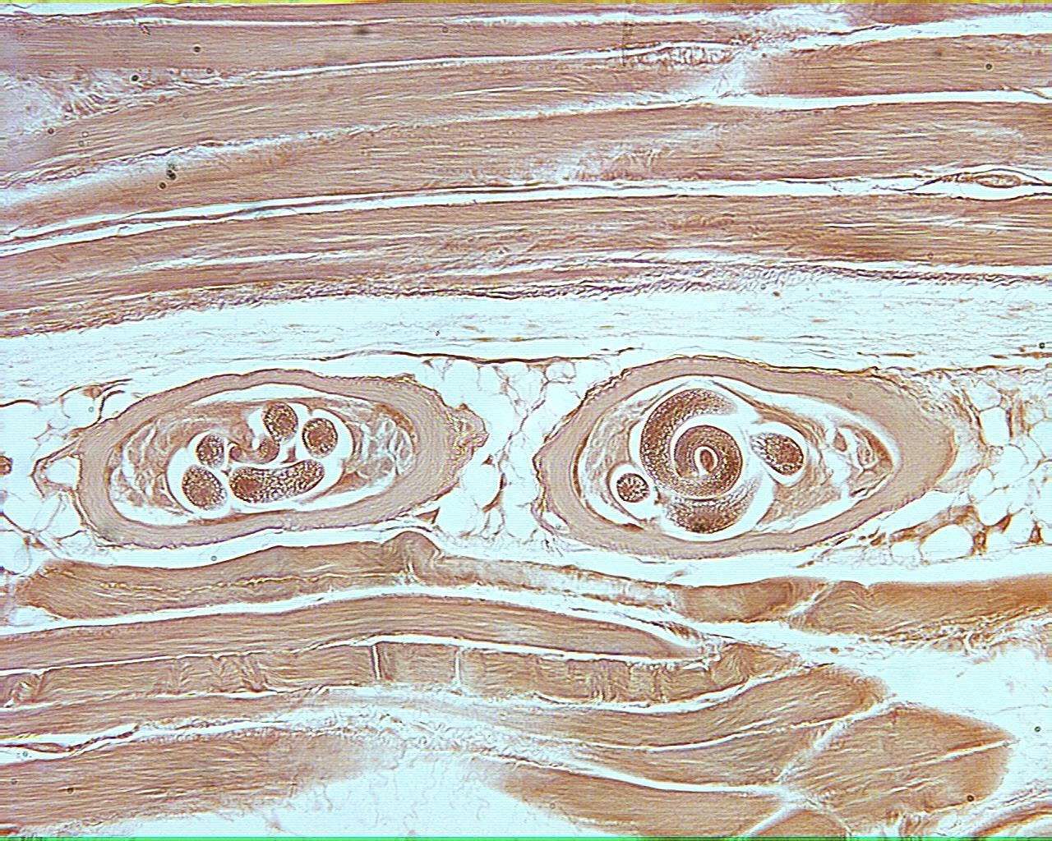
Trichinella in pig muscle

Slide 20
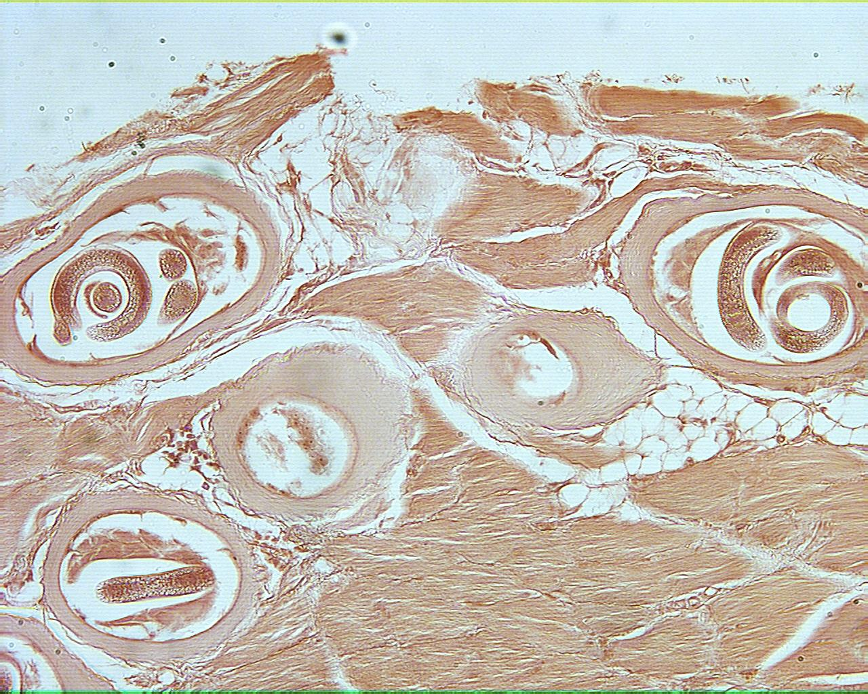
Trichinella in pig muscle

Slide 21
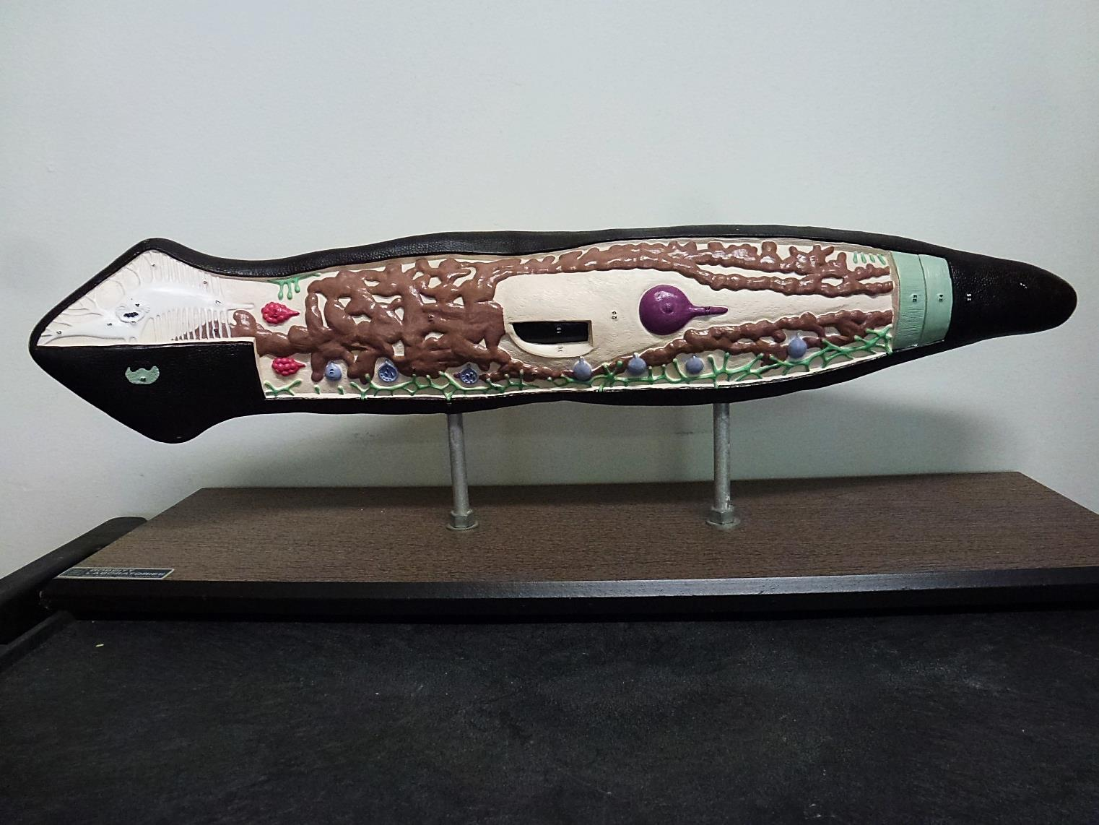
Planaria Model

Slide 22
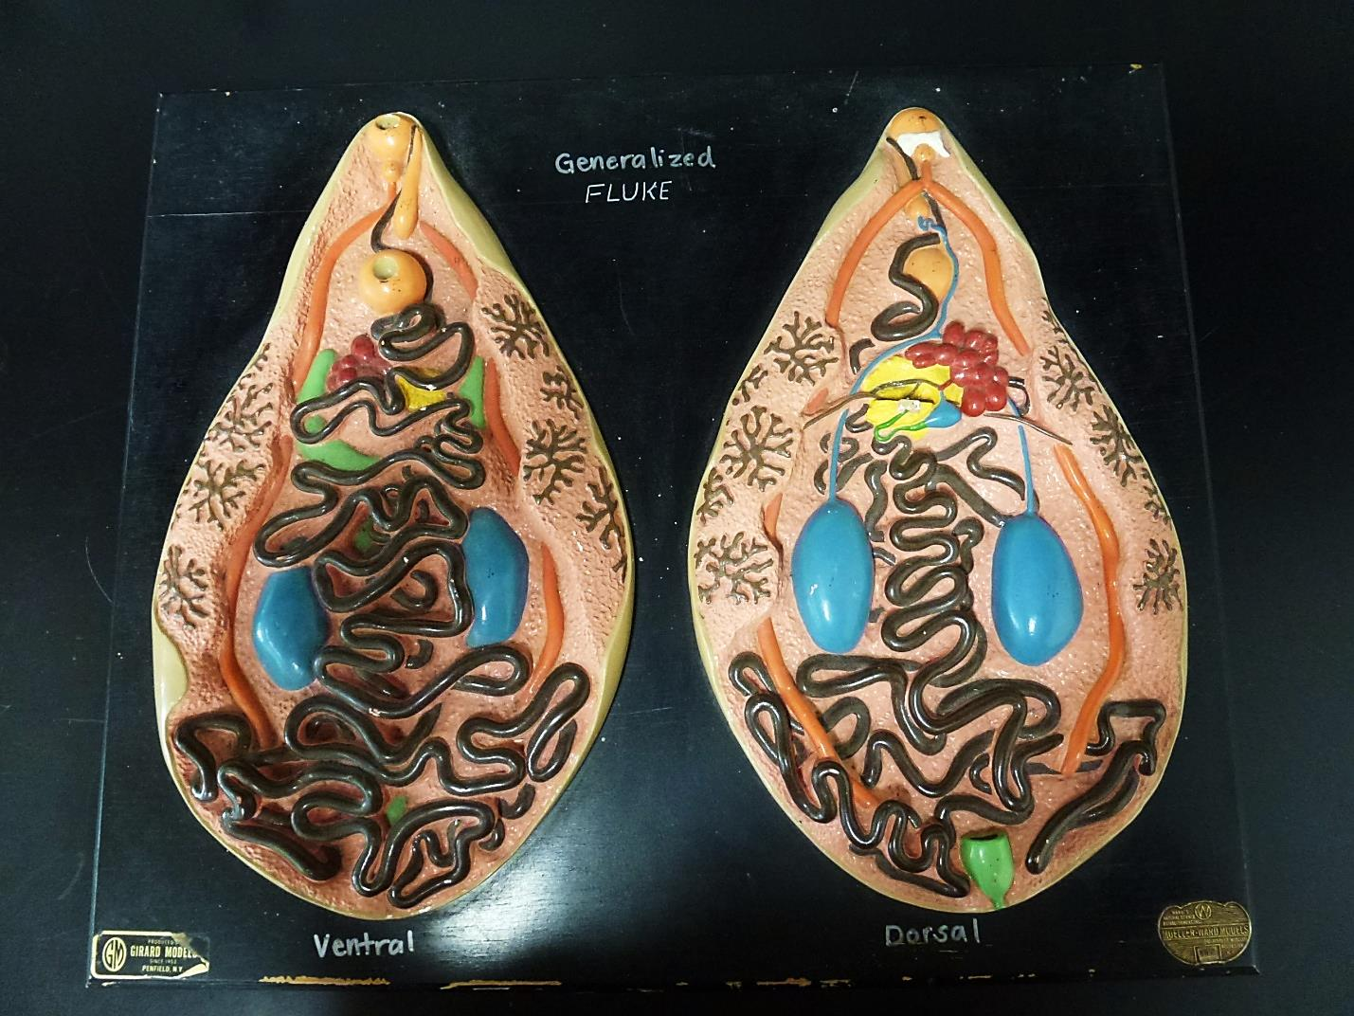
Generalized Fluke Model

Slide 23
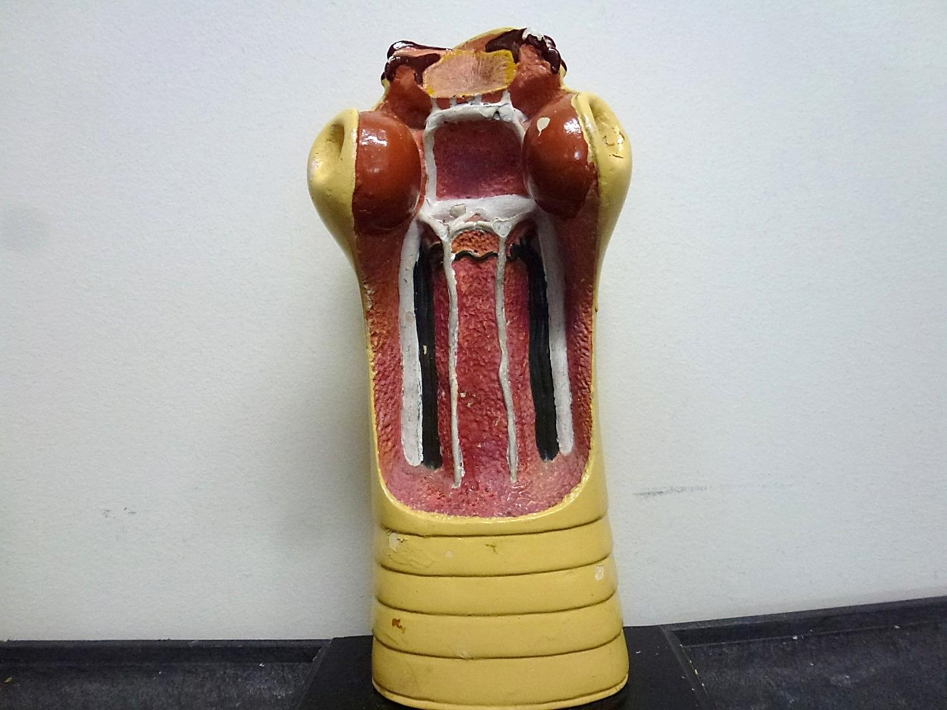
Tapeworm Scolex Model

Slide 24
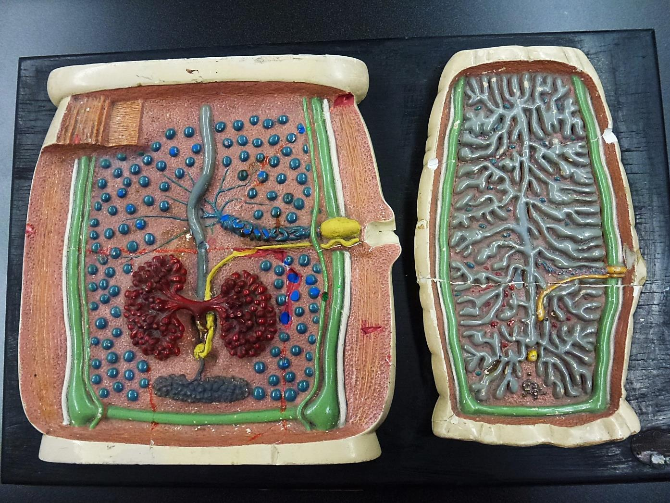
Tapeworm Proglottid Model

